Slide 1

FSDI 116 Software Development Methodology Fundamentals
Introduction

Slide 2
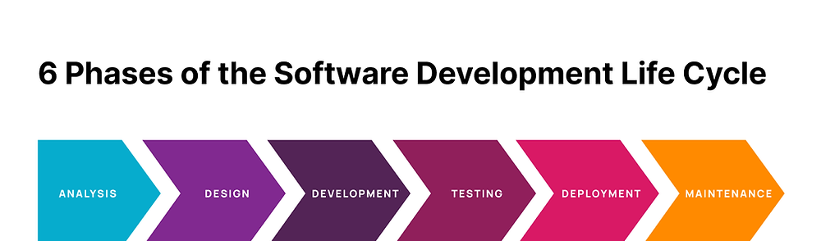
Software Development Life Cycle

Slide 3
What is it and why we should use it?
The software development lifecycle (SDLC) is the process that development teams use to design and build high-quality software.
The goal of SDLC is to minimize project risks through forward planning so that software meets customer expectations during production and beyond.
This methodology outlines a series of steps that divide the software development process into tasks you can assign, complete, and measure.
Notes:
What? - High-Quality: However, it's essential to note that achieving high quality in software development is an ongoing process that involves various phases and continuous improvement efforts throughout the SDLC. Why? - High-quality.
- Low-risks.

Slide 4
Common SDLC phases
The details of the SDLC process vary for different teams. However, we outline some common SDLC phases.

Slide 5
6 Phases of the SDLC
Plan The team collects requirements from several stakeholders such as customers, internal and external experts, and managers to create a software requirement specification document. Also, this phase typically includes tasks like cost-benefit analysis, scheduling, resource estimation, and allocation.
Design Software engineers analyze requirements and identify the best solutions to create the software.
Implement The development team codes the product. They analyze the requirements to identify smaller coding tasks they can do daily to achieve the final result.
Test The development team combines automation and manual testing to check the software for bugs. Quality analysis includes testing the software for errors and checking if it meets customer requirements.
Deploy When teams develop software, they code and test on a different copy of the software than the one that the users have access to. The deployment phase includes several tasks to move the latest build copy to the production environment, such as packaging, environment configuration, and installation.
Maintain Among other tasks, the team fixes bugs, resolves customer issues, and manages software changes.
Notes:
Stakeholders:
Customers.
Competitors.
Professionals in the field: Medical Professionals.

Slide 7
SDLC models
Traditional and non-traditional

Slide 8
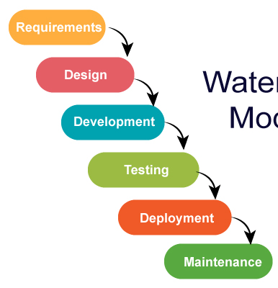

Traditional model: Waterfall
The waterfall model arranges all the phases sequentially so that each new phase depends on the outcome of the previous phase.
What if we make mistakes in the planning phase
or need to make some changes?
Notes:
The planning must be completed before any work begins and in most cases the planning is done without entirely understanding the project.
A bad planning will take us back from next stages. That is, we would have mistakes and it will be necessary to go back.
It mean that we are going to spend time trying to fix errors of the planning phase and this can takes a considerable time before we have a first version of the product.

Slide 9
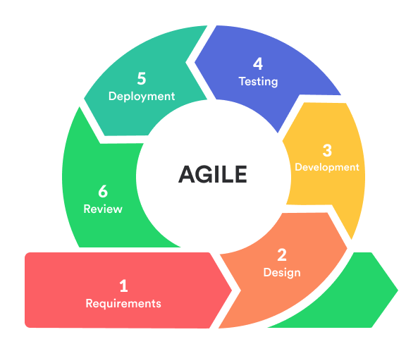
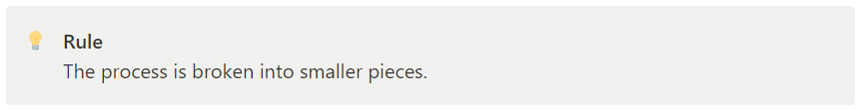
Non-traditional models: Agile philosophy
Non-traditional models commonly follow the agile philosophy. That means they work with a different approach for software development and they responsiveness to change.
Notes:
The process is broken up into smaller pieces first.
We do just enough planning to get started with building the minimal feature set.
Then we build what planned.
Next we test and review that small feature set.
And get it ready to ship.

Slide 10
Agile
A way to be aware of the fact that circumstances are changing and knows how to respond smartly

Slide 11
Manifesto for Agile Software Development
We are uncovering better ways of developing software by doing it and helping others do it. Through this work we have come to value:
Individuals and interactions over processes and tools.
Working software over comprehensive documentation.
Customer collaboration over contract negotiation.
Responding to change over following a plan.
agilemanifesto.org

Slide 12
Manifesto for Agile Software Development
Individuals and interactions over processes and tools. Agile encourages open communication, teamwork, and shared understanding among team members.
Working software over comprehensive documentation. While documentation is valuable, Agile suggests that the main focus should be on producing software that can be tested, validated, and used by stakeholders.
Customer collaboration over contract negotiation. Rather than relying solely on contractual agreements, Agile values ongoing communication and a partnership approach with customers.
Responding to change over following a plan. Instead of rigidly adhering to a predefined plan, Agile teams are encouraged to be adaptable and responsive.

Slide 13
Principles behind the Agile manifesto
Our highest priority is to satisfy the customer through early and continuous delivery of valuable software.
Welcome changing requirements, even late in development. Agile processes harness change for the customer's competitive advantage.
Deliver working software frequently, from a couple of weeks to a couple of months, with a preference to the shorter timescale.
Business people and developers must work together daily throughout the project.
Build projects around motivated individuals.
Give them the environment and support they need, and trust them to get the job done.
The most efficient and effective method of conveying information to and within a development team is face-to-face conversation.
Agile Manifesto Principles

Slide 14
Principles behind the Agile manifesto
Working software is the primary measure of progress.
Agile processes promote sustainable development.
The sponsors, developers, and users should be able to maintain a constant pace indefinitely.
Continuous attention to technical excellence and good design enhances agility.
Simplicity--the art of maximizing the amount of work not done--is essential.
The best architectures, requirements, and designs emerge from self-organizing teams.
At regular intervals, the team reflects on how to become more effective, then tunes and adjusts its behavior accordingly.
Agile Manifesto Principles

Slide 15
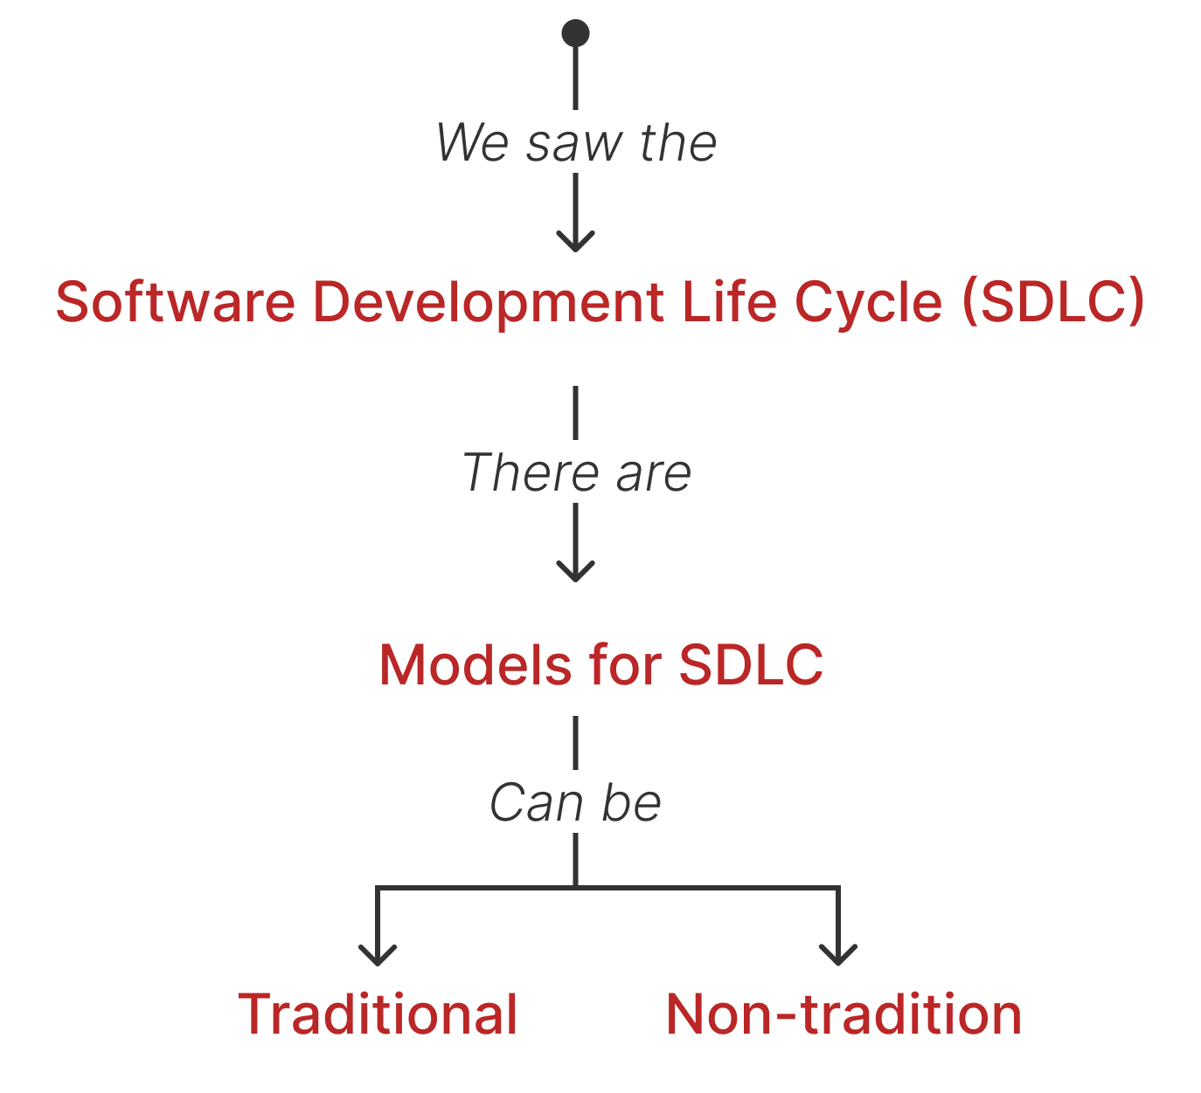
Summary

Slide 16
SCRUM
An agile framework for software development
scrum.org

Slide 17
Software Development Life Cycle

Slide 18
You will be able to answer:
What is SCRUM?
What are the SCRUM roles?
What are they responsibilities?
What are the artifacts?
What are the ceremonies?

Slide 19
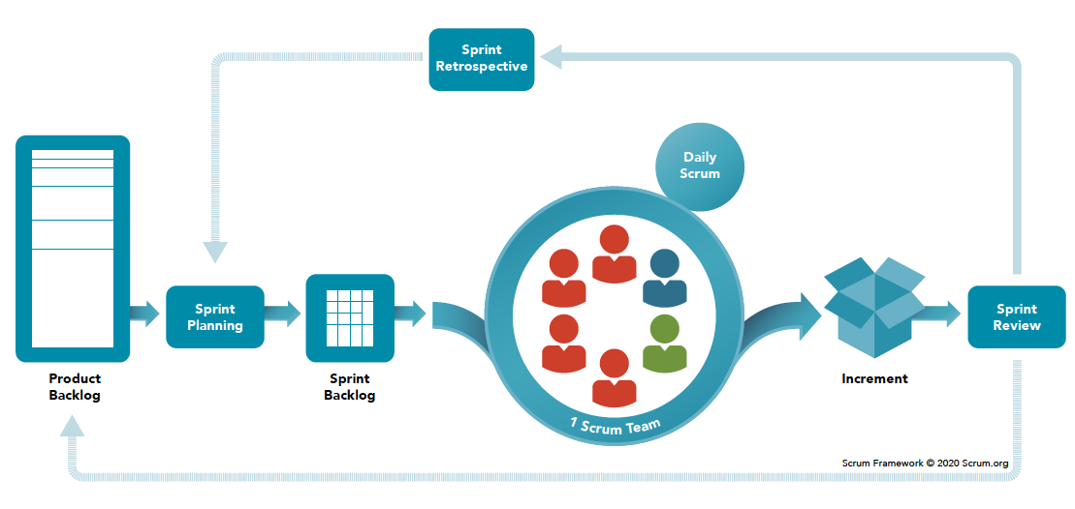
The Scrum Framework Poster
Go to SCRUM.org

Slide 20
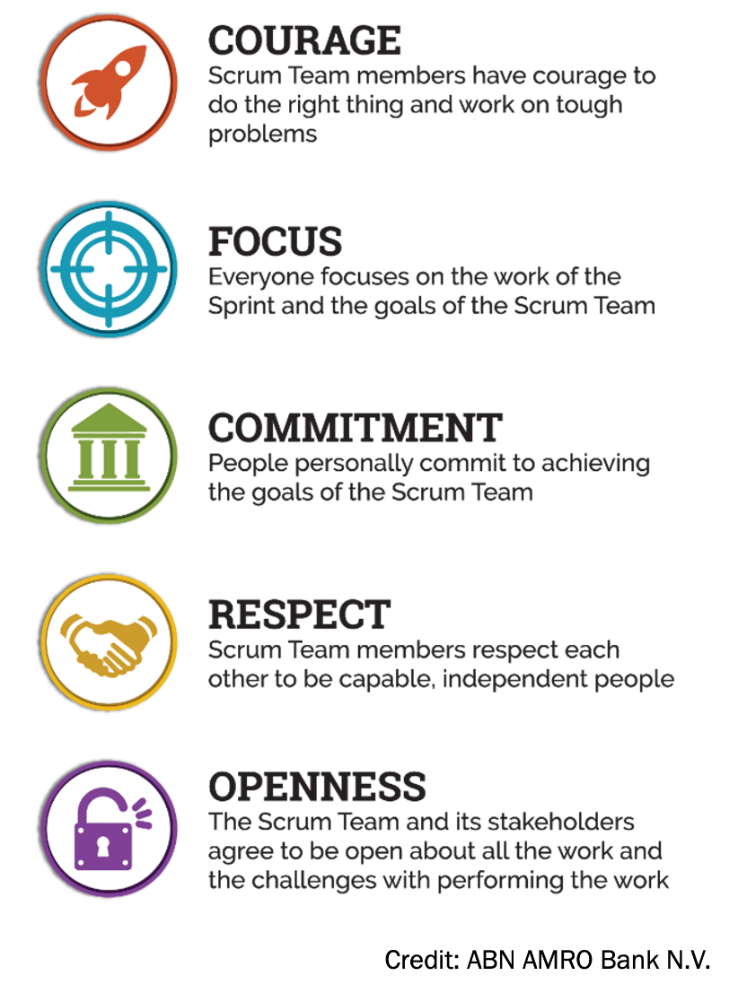
What is SCRUM?
You can think in Scrum as a way to get work done as a team in small pieces at a time, with continuous experimentation and feedback loops along the way to learn and improve as you go.
Scrum helps people and teams deliver value incrementally in a collaborative way.
As an agile framework, Scrum provides just enough structure for people and teams to integrate into how they work, while adding the right practices to optimize for their specific needs.
Scrum is not a methodology, it is a framework!

Slide 21
The flow

Slide 22
Ceremonies, roles, and artifacts.
Artifact
Ceremony
Ceremony
Artifact
Artifact
Ceremony
Ceremony
Roles
Product Owner
Scrum
Master
Development Team

Slide 23
Let’s work as a Product Owner
The software product requirements as user stories

Slide 24
Tasks of a product owner
Represent the client.
Convey the right message for requirements.
Build and manage the product backlog.
Manage releases.
Verify and accept the sprint result.

Slide 25
User Stories
A User Story is a requirement.
The structure of a user history is:
As a <role> I want <goal>, so that <benefit>.

Slide 26
User Stories: Examples
USER STORIES FOR AN ISSUE MANAGER SYSTEM
Example 1:
As a project manager I want to assign issues to specific team members, so that the responsibilities are clear and progress can be tracked efficiently.

Slide 27
User Stories: Examples
USER STORIES FOR AN ISSUE MANAGER SYSTEM
Example 2:
As a developer I want to be notified when an issue is assigned to me, so that I can promptly start working on it.

Slide 28
User Stories: Examples
USER STORIES FOR AN ISSUE MANAGER SYSTEM
Example 3:
As a team member I want to categorize issues with labels or tags, so that I would organize and prioritize tasks, making it easier to address urgent matters.

Slide 29
Activity 1
The project is to create a website as a portfolio of your work as a developer. Write two user stories.

